Slide 1
Finite Automata
Motivation
An Example

Slide 2
Informal Explanation
Finite automata are finite collections of states with transition rules that take you from one state to another.

Slide 3
Representing FA
Simplest representation is often a graph.
Nodes = states.
Arcs indicate state transitions.
Labels on arcs tell what causes the transition.

Slide 4
Example: Recognizing Strings Ending in “ing”: RE = <letter>*ing
Not i
Not i or g
i
Not i
Not i or n
i
nothing
Saw i
Saw in
Saw ing
i
n
g
i
Start

Slide 5
Example: Automata to Code
/* state-1: no “i” was seen yet */
s1: c = getNextInput();
if(c != ‘i’) goto s1
/* state-2: “i” was seen */
s2: c = getNextInput();
if(c == ‘i’) goto s2;
else if(c == ‘n’) goto s3;
else goto s1;
s3: /* state-3: ”in” was seen */
. . .

Slide 6
Automata to Code – Thoughts
How would you do this in Java, which has no goto?
You don’t really write code like this.
Rather, a code generator takes a “regular expression” describing the pattern(s) you are looking for.
Example: .*ing works in grep.

Slide 7
Deterministic Finite Automata (DFA)
A DFA consists of:
A finite set of states (Q).
An input alphabet (Σ).
A start state (q₀ is in Q)
A set of final/accepting states (F ⊆ Q)
A transition function (δ: Q x Σ → Q)
δ(q_{i}, a) = q_{j} indicates that if the current state is q_{i} and it just read the symbol a then the DFA goes from state q_{i} to state q_{j}
A DFA, M = (Q, Σ, q₀, F, δ)
In a DFA, each state must have a unique outgoing arc for each symbol in Σ

Slide 8
Graph Representation of DFA’s - Transition Diagram
Nodes = states.
Arcs represent transition function.
Arc from state p to state q labeled by all those input symbols that have transitions from p to q.
Arrow labeled “Start” to the start state.
Final states indicated by double circles.

Slide 9
Example: Transition diagram of a DFA
Accepts all strings without two consecutive 1’s.
0
0,1
1
1
A
B
C
Start
0
Previous
string OK,
does not
end in 1.
Previous
String OK,
ends in a
single 1.
Consecutive
1’s have
been seen.

Slide 10
Alternative Representation: Transition Table
Final states
starred
Columns =
input symbols
0
1
*
A A B
B A C
C C C
Arrow for
start state
*
Rows = states
0
0,1
A
1
B
1
C
Start
0

Slide 11
Extended Transition Function
We describe the effect of a string of inputs on a DFA by extending δ to a state and a string.
Induction on length of string.
Basis: δ(q, ε) = q
Induction: δ(q,wa) = δ(δ(q,w),a)
w is a string; a is an input symbol.

Slide 12
Extended δ: Intuition
Convention:
… w, x, y, z are strings.
a, b, c,… are single symbols.
Extended δ is computed for state q and inputs a₁a₂…a_{n} by following a path in the transition graph, starting at q and selecting the arcs with labels a₁, a₂,…,a_{n} in turn.

Slide 13
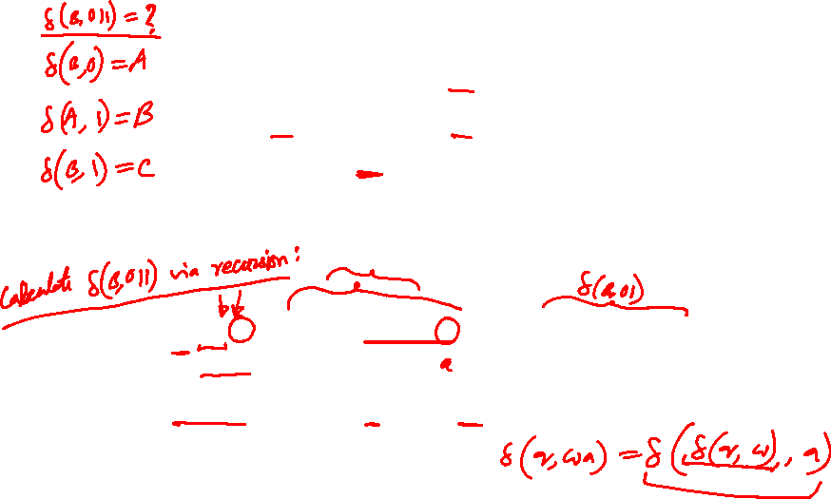
Example: Extended Delta
0
1
A A B
B A C
C C C
δ(B,011) = δ(δ(B,01),1) = δ(δ(δ(B,0),1),1) =
δ(δ(A,1),1) = δ(B,1) = C

Slide 14
Delta-hat
In book, the extended δ has a “hat” to distinguish it from δ itself.
Not needed, because both agree when the string is a single symbol.
δ(q, a) = δ(δ(q, ε), a) = δ(q, a)
˄
˄
Extended deltas

Slide 15
Language of a DFA
Automata of all kinds define languages.
If A is an automaton, L(A) is its language.
For a DFA A, L(A) is the set of strings labeling paths from the start state to a final state.
L(A) is the set of strings accepted by A
Formally: L(A) = {w ε Σ*: δ(q₀, w) ε F}

